Slide 1
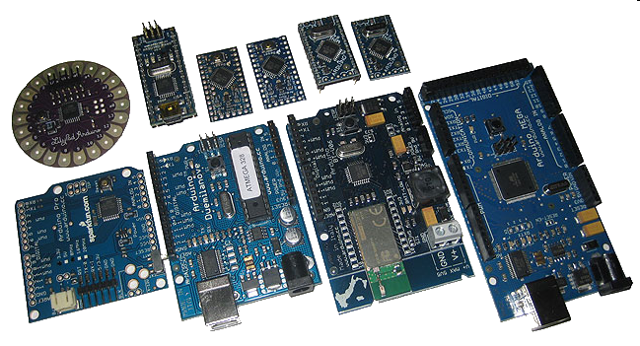
Arduino Types
Many different versions
Number of input/output channels
Form factor
Processor
Leonardo
Due
Micro
LilyPad
Esplora
Uno

Slide 2
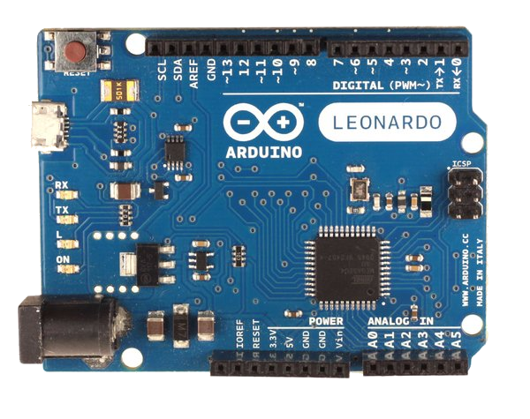
Leonardo
Compared to the Uno, a slight upgrade.
Built in USB compatibility
Bugs?
Presents to PC as a mouse or keyboard

Slide 3
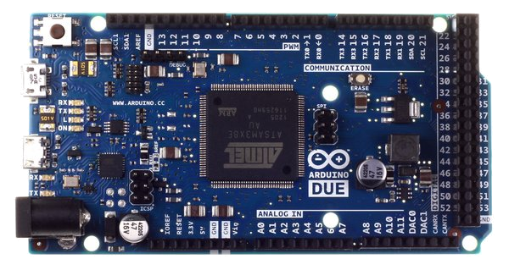
Due
Much faster processor, many more pins
Operates on 3.3 volts
Similar to the Mega

Slide 4
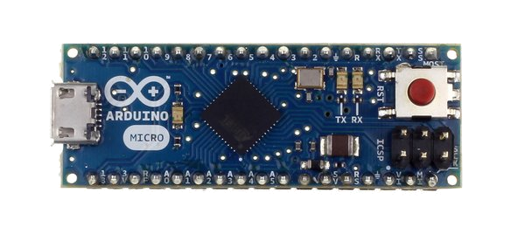
Micro
When size matters: Micro, Nano, Mini
Includes all functionality of the Leonardo
Easily usable on a breadboard

Slide 5
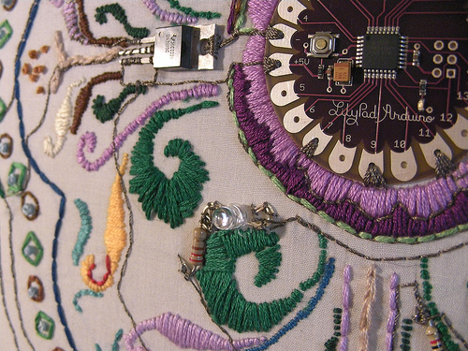
LilyPad
LilyPad is popular for clothing-based projects.

Slide 6
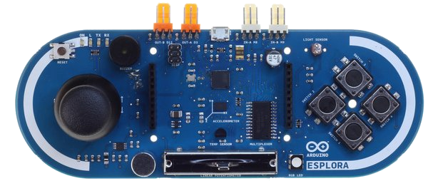
Esplora
Game controller
Includes joystick, four buttons, linear potentiometer (slider), microphone, light sensor, temperature sensor, three-axis accelerometer.
Not the standard set of IO pins.

Slide 7
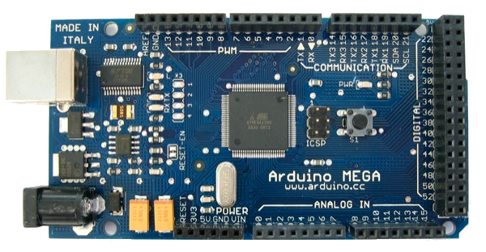
Mega
Compared to the Uno, the Mega:
Many more communication pins
More memory
Some interface hardware doesn't work

Slide 8
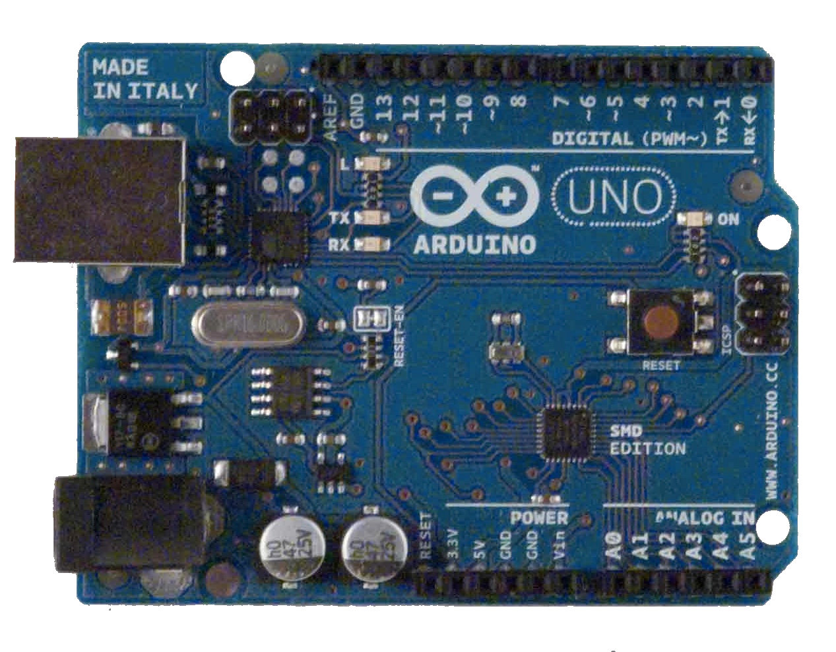
Arduino Uno Close Up
The pins are in three groups:
Invented in 2010
14 digital pins
6 analog pins
power

Slide 9
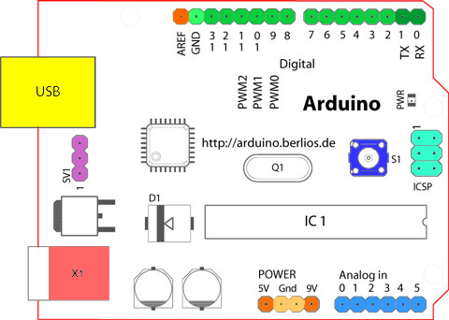
Arduino Board Overview
USB chip
Digital input/output pins
USB connector
Power LED
Reset button
Microcontroller
chip
Power connector
Power
pins
Analog
Input
pins

Slide 10
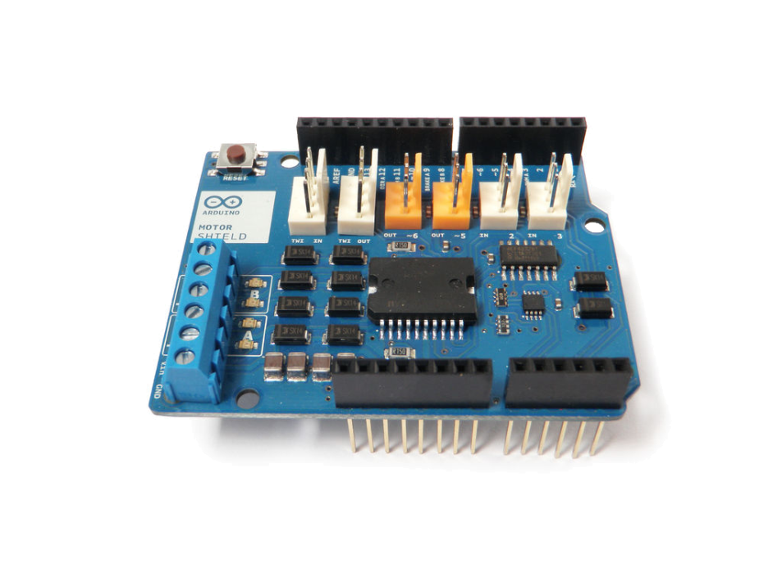
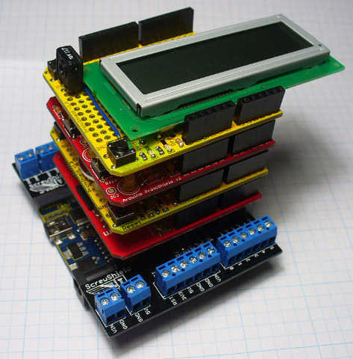
Shields
Shields are circuit boards that plug into the top of an Arduino.
They extend the capabilities of an Arduino.
Examples:
Ethernet
GPS
Motor
Prototype
shieldlist.org

Slide 11
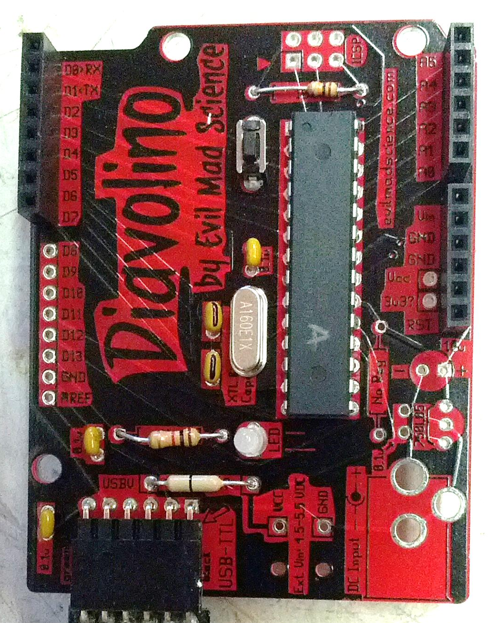
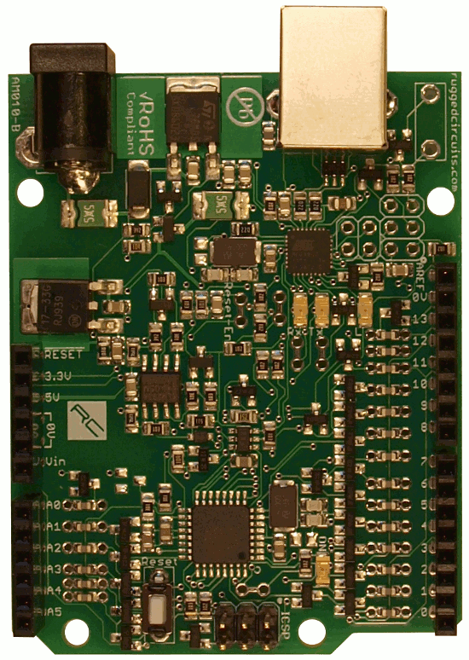
Compatible Boards
These are two of MANY!
Notes:
This is the Diavolino and the Ruggeduino. The Diavolino is a low cost board ($12 at Micro Center) that off-loads the USB processing to another board. It is a kit. The Ruggeduino is built for beginners and has fuses and other limiting components to nearly eliminate the possibility of damaging the board.
These are two of many. Since Arduino is open, anyone can make boards, and many have extended boards for special purposes, such as robots, flight simulation, video games, radio control vehicles, and for prototyping.

Slide 12
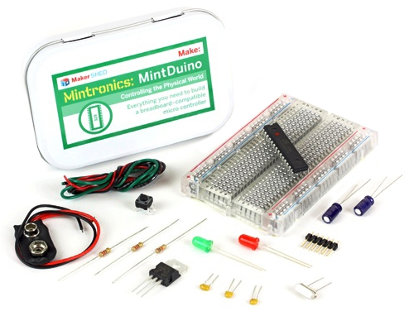
Compatible Boards

Slide 13
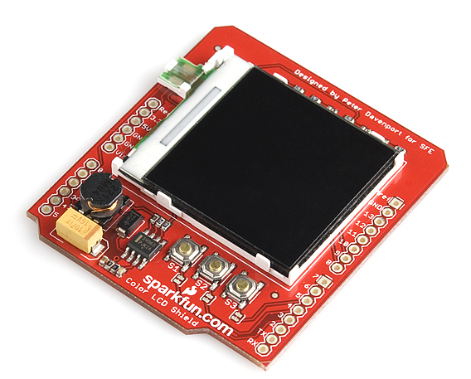
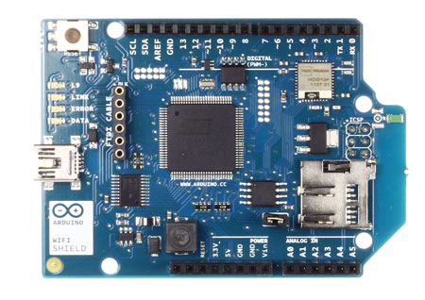
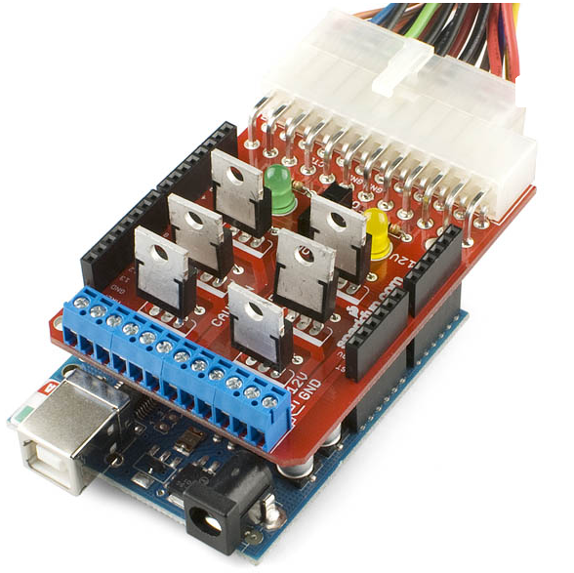
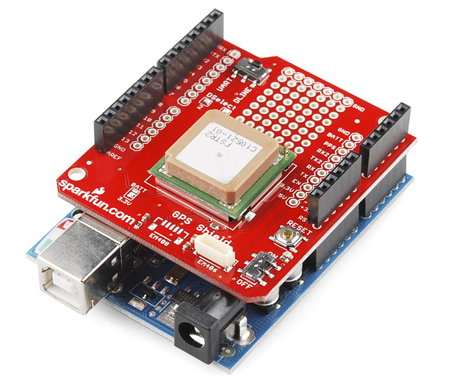
Shields
Notes:
Shields connect to the I/O board to extend it's functionality. Hundreds of shields are available, and you can make your own.
Starting from the upper left going clockwise:
Wireless Network Shield
Color LCD Shield
Power Driver Shield (connects to a computer power supply).
GPS Shield
Shields can run as low as $15, as high as $200.
Bluetooth $40-$65
LCD: $40
GPS: $80
Power Driver: $20

Slide 14
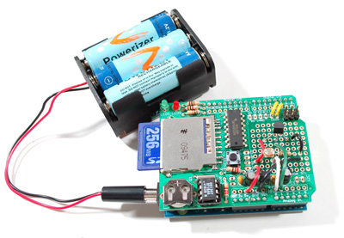
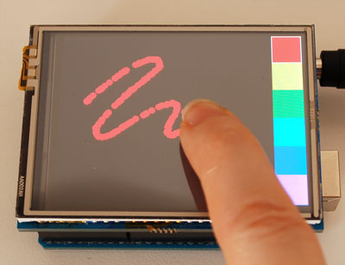
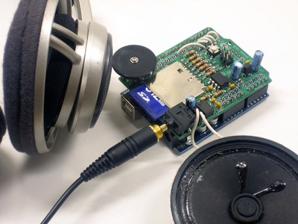
Shields
Datalogging Shield
Wave Shield
Touchscreen Shield
Notes:
The shield on the left is a touchscreen shield, the upper right is a light and temperature shield, and the lower right is a sound (music) shield.

Slide 15
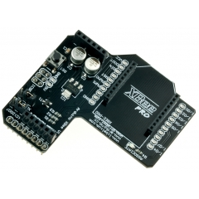
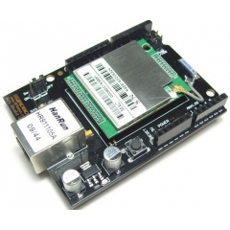
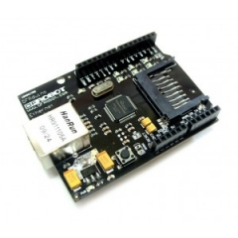
More Shields…
XBee Shield
Ethernet Shield
Wifi Shield
Notes:
Communication shields - XBee, Ethernet, and Wifi (2.5 Ghz).
These run around $60-$80.

Slide 16
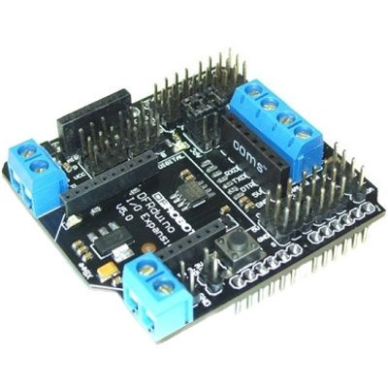
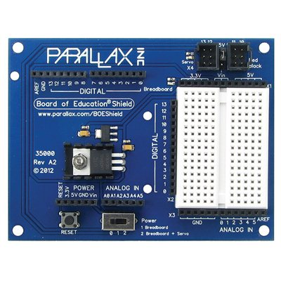
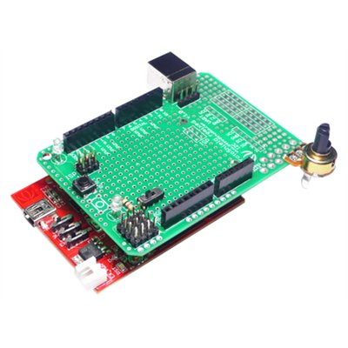
And more shields…

Slide 17
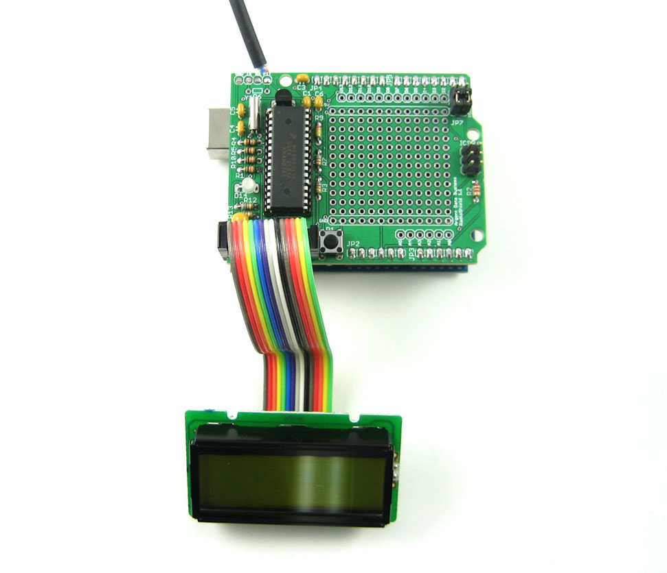
Even more shields!
APRS Shield

Slide 18
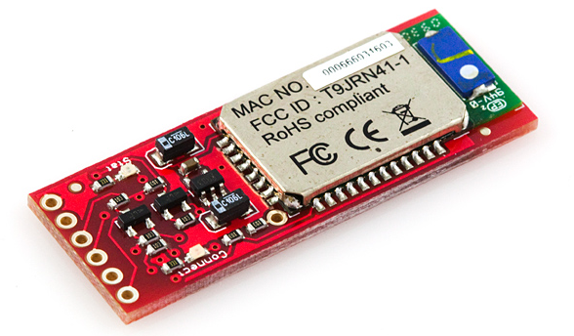
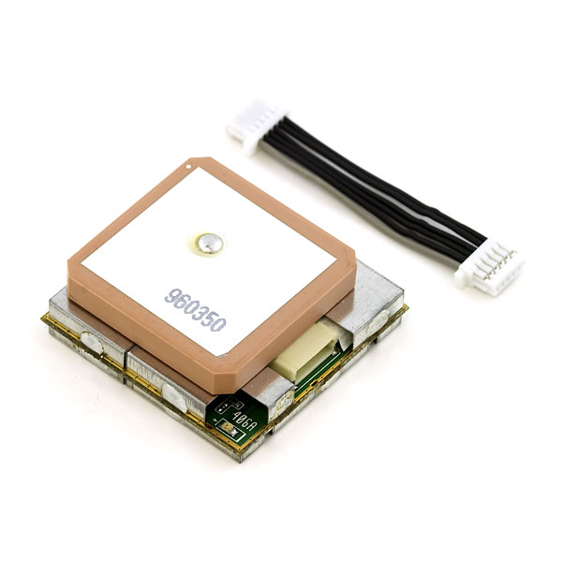
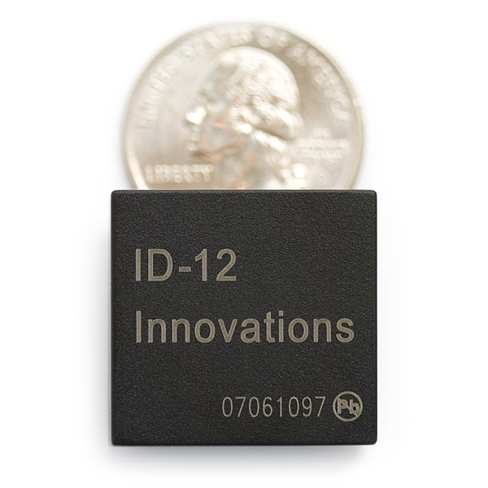
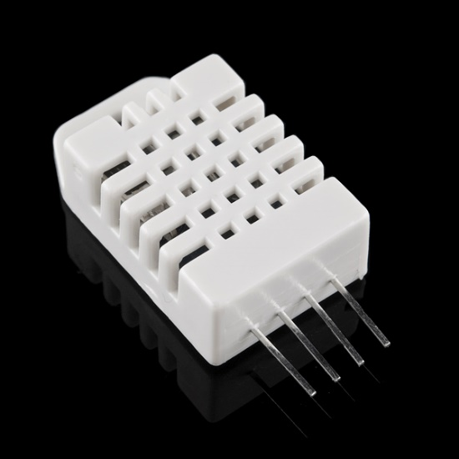
Modules
Bluetooth Module
GPS Module
Temperature & Humidity Sensor
RFID Module
Notes:
Modules send serial data strings to the Arduino.

Slide 19
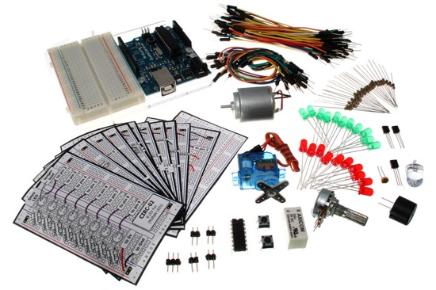
Arduino Starter Kits
Start with a combo pack (starter kit)
Includes a microcontroller, wire, LED's, sensors, etc.
www.adafruit.com
adafruit.com/products/68 ($65)
www.sparkfun.com
https://www.sparkfun.com/products/11576 ($99.95)
Radio Shack
Make Ultimate Microcontroller Pack w/ Arduino Kit ($119.99)
www.makershed.com
http://www.makershed.com/Ultimate_Arduino_Microcontroller_Pack_p/msump1.htm ($150)

